Slide 1
Practical Private Range Search Revisited
Ioannis Demertzis*
University of Maryland
yannis@umd.edu
Stavros Papadopoulos
Intel Labs & MIT
stavrosp@csail.mit.edu
Odysseas Papapetrou*
EPFL, Lausanne, Switzerland
odysseas.papapetrou@epfl.ch
Antonios Deligiannakis
Technical University of Crete
adeli@softnet.tuc.gr
Minos Garofalakis
Technical University of Crete
minos@softnet.tuc.gr
*Work performed while the author was at the Technical University of Crete

Slide 2
Cloud Computing
Pros:
Near infinite scalability for big data analytic
Easy and ubiquitous access on solid data
Cost reduction with the use of shared infrastructure
+ Affordable for small and medium businesses
Cons:
- Serious security and privacy concerns regarding outsourcing and querying on private company or personal data
Solution: Privacy Preserving Querying
Notes:
2

Slide 3
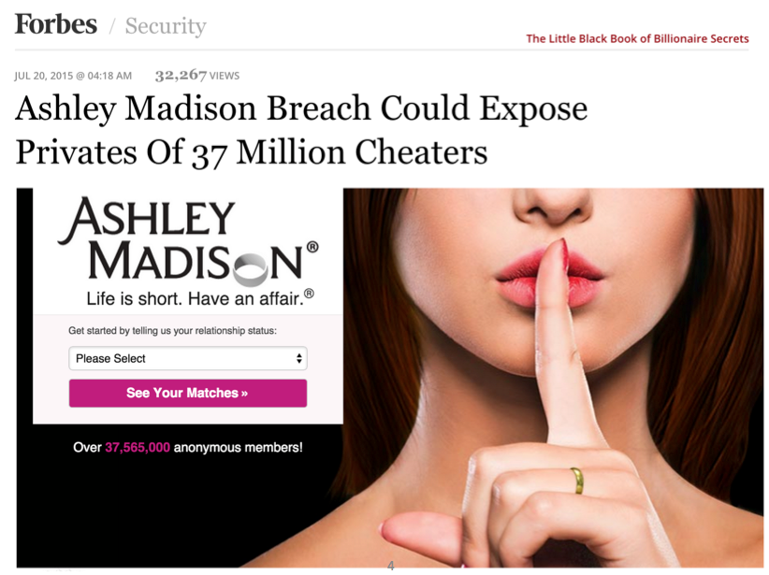
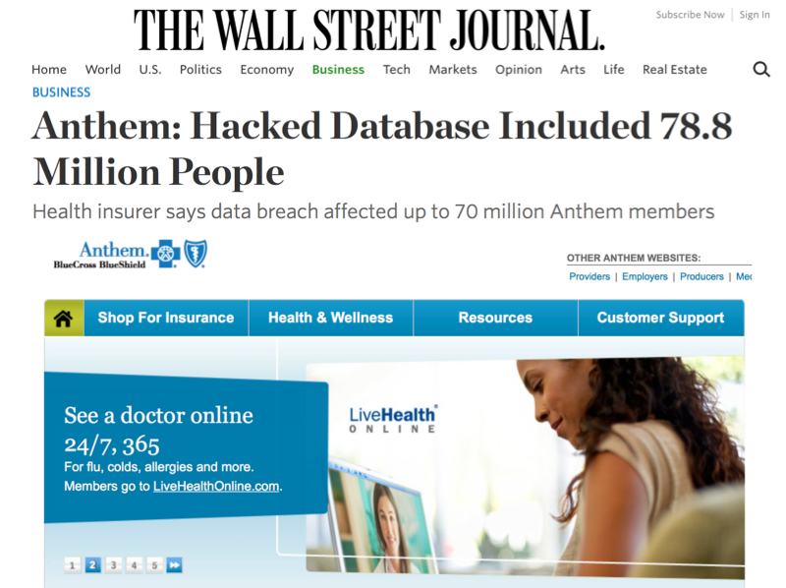

Slide 4
IDEAL SOLUTION Privacy Preserving Querying
Encrypt(DB)
Client
?
Encrypted
Database
Later:
Encrypted(query)
Untrusted Cloud
Client
Encrypted(results)

Slide 5
Solutions for Encrypted Search
PPE
Secure & Efficient
High
…
CryptDB
MONOMI
OPE
DET
SSE
CipherBase
Google BigQuery
Microsoft SQL 2016 Always Encrypted
Efficiency
Efficient
ORAM
Func/Pred Enc
Secure
FHE
Low
High
Security
Not all schemes are explained (Feel free to ask me during the poster session!!)

Slide 6
Why? Practical Private Range Search?
No Practical and Secure solution!
Our Contribution: Range Searchable Symmetric Encryption (RSSE) schemes
Notes:
6

Slide 7
Related Work – Private Range Search
Hacigumus et al. (2002)
Hore et al. (2004, 2012)
High
PPE
Secure & Efficient
OPE
DET
RSSE
?
Popa et al. (2013)
Kerschbaum et al. (2014)
Ostrovsky et. al (1990)
Goldreich et. al (1996)
Stefanov et al. (2011,2013,
2013)
Efficiency
Efficient
Li et al. (2015)
ORAM
Func/Pred Enc
Boneh et al. (2007)
Shi et al. (2007)
Lu et al. (2012)
Secure
Gentry et al. 2010
FHE
Low
High
Security
Not all schemes are explained (Feel free to ask me during the poster session!!)

Slide 8
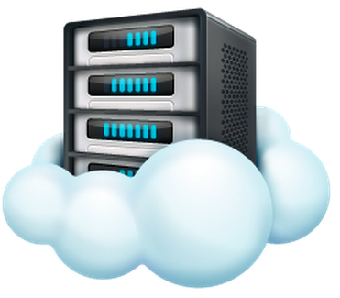
What is Searchable Symmetric Encryption?
Leakage is the amount of information that the untrusted cloud learns
Untrusted
Cloud
Client
?
search query:
keyword

Slide 9
Searchable Symmetric Encryption (SSE) schemes
Client
Untrusted
Cloud
k1
F1
F4
F2
k2
F3
F6
F4
F2
k3
F5
F1
F1
F2
F3
F4
F5
F6

Slide 10
Searchable Symmetric Encryption (SSE) schemes
Client
Untrusted
Cloud
k1
F1
F4
F2
k2
F3
F6
F4
F2
k3
F5
F1
F1
F2
F3
F4
F5
F6

Slide 11
Searchable Symmetric Encryption (SSE) schemes
Client
L1 leakage: total leakage prior to query execution
e.g. size of each encrypted file, size of encrypted index
Untrusted
Cloud
k1
F1
F4
F2
k2
F3
F6
F4
F2
k3
F5
F1
F1
F2
F3
F4
F5
F6

Slide 12
Searchable Symmetric Encryption (SSE) schemes
Search pattern: whether a search query is repeated
L2 leakage (leakage during query execution)
Client
Untrusted
Cloud
token
k1
k1
F1
F4
F2
k2
F3
F6
F4
F2
k3
F5
F1
F1
F2
F3
F4
F5
F6
Access pattern: encrypted document ids and files that satisfy the search query

Slide 13
Security Game
Real Scheme
Simulator
L1 (
)
Enc (
) + Enc(
)
&^*@h@&*^H4&*24
w1 | L2( w1 )
w1
token1
Adversary
^&*daUY@#*
…
…
wN
wN | L2( wN)
tokenN
&k*&()#&*@
Notes:
13

Slide 14
Trivial Solution 1 - Quadratic Approach
Untrusted
Cloud
Main idea: Replicate each tuple to all possible ranges
it belongs to (For domain [0,m] ➔ O(m²) possible ranges)
Client
SELECT *
FROM TABLE as T
WHERE T.SALARY ≥ 2K
and T.SALARY ≤ 3K
1
F1
F4
F2
2
F3
F6
F4
F2
3
F5
F1
2-3
1-2
F1
F4
F2
F3
F6
F4
F2
2-3
F3
F6
F4
F2
F5
F1
1-3
F1
F4
F2
F3
F6
F4
F2
F5
F1
Optimal Security - O(1) Query Size - O(r) Search Time - O(nm²) Space – No False Positives n: dataset size, r: result size, m: domain size , R: query range size

Slide 15
Trivial Solution 2 – Linear Approach
Client
Untrusted
Cloud
Main idea: Transform the range queries to point queries
SELECT *
FROM TABLE as T
WHERE T.SALARY ≥ 1K
and T.SALARY ≤ 8K
1
2
3
4
5
6
7
8
1
2
3
4
5
6
7
8
F1
F6
F3
F5
F4
F2
Weaker Security - O(R) Query Size – O(R+r) Search Time - O(n) Space – No False Positives n: dataset size, r: result size, m: domain size , R: query range size

Slide 16
Linear Approach (BRC-URC)
Client
Untrusted
Cloud
Main idea: Use Delegatable-PRFs (DPRFs) Kiayas et al.CCS’13
SELECT *
FROM TABLE as T
WHERE T.SALARY ≥ 1K
and T.SALARY ≤ 8K
a
a
b
c
d
e
f
g
1
2
3
4
5
6
7
8
F1
F6
F3
F5
F4
F2
Weaker Security - O(logR) Query Size - O(logR+r) Search Time - O(n) Space – No False Positives n: dataset size, r: result size, m: domain size , R: query range size

Slide 17
Logarithmic-Best Range Cover Approach
Client
Untrusted
Cloud
Main idea: Increase the space by replicating each tuple to
the dyadic intervals in which it belongs (xlogm)
F2
F4
F1
F6
F3
F5
1-8
F2
F4
F1
1-4
F6
F3
F5
5-8
F3
F5
F2
F4
F1
1-2
3-4
F6
5-6
7-8
1
2
3
4
5
6
7
8
F1
F6
F3
F5
F4
F2
Intermediate Security - O(logR) Query Size - O(logR+r) Search Time - O(nlogm) Space – No False Positives n: dataset size, r: result size, m: domain size , R: query range size

Slide 18
Logarithmic-Best Range Cover Approach
Client
Untrusted
Cloud
Main idea: Answer the queries with the minimum number
of nodes which cover the range
1-4
BRC(1,4) =
1-8
2
3-4
5
BRC(2,5) =
1-4
5-8
1-2
3-4
5-6
7-8
Equal size ranges have tokens
of unequal size
1
2
3
4
5
6
7
8
Complex tokens have
a specific structure
Intermediate Security - O(logR) Query Size - O(logR+r) Search Time - O(nlogm) Space – No False Positives n: dataset size, r: result size, m: domain size , R: query range size

Slide 19
Logarithmic-Uniform Range Cover Approach
Client
Untrusted
Cloud
Main idea: Answer all the queries with the same size
with the same number of tokens
1
2
3-4
URC(1,4) =
1-8
2
3-4
5
URC(2,5) =
1-4
5-8
1-2
3-4
5-6
7-8
Equal size ranges have tokens
of unequal size
1
2
3
4
5
6
7
8
Complex tokens have
a specific structure
Solved by Logarithmic-SRC/Logarithmic SRCi
Intermediate Security - O(logR) Query Size - O(logR+r) Search Time - O(nlogm) Space – No False Positives n: dataset size, r: result size, m: domain size , R: query range size

Slide 20
Logarithmic-Single Range Cover Approach
Client
Untrusted
Cloud
Main idea: Answer all the queries with one token
SRC(4,5) =
1-8
1-8
O(n) False Positives
1-4
5-8
1-2
3-4
5-6
7-8
1
2
3
4
5
6
7
8
False Positives
Actual Answer
False Positives
Optimal Security – O(1) Query Size - O(n) Search Time - O(nlogm) Space – O(n) False Positives n: dataset size, r: result size, m: domain size , R: query range size

Slide 21
Logarithmic-Single Range Cover Approach
Client
Untrusted
Cloud
Main idea: Augment the tree structure with extra nodes
without increasing asymptotically the space
SRC(4,5) =
4-5
1-8
O(range) False Positives values
1-4
3-6
5-8
All the tuples have value = 1
1-4
SRC(2,4) =
1-2
2-3
3-4
4-5
5-6
6-7
7-8
O(n) False Positives
1
2
3
4
5
6
7
8
If we have only one value per leaf then
O(result size) False Positives
False
Positive
value
Actual Values
Flatten the distribution
(Assign one value per leaf)
Logarithmic SRCi
Optimal Security - O(1) Query Size - O(n) Search Time - O(nlogm) Space – O(n) False Positives n: dataset size, r: result size, m: domain size , R: query range size

Slide 22
Logarithmic-Single Range Cover-i Approach
Client
Untrusted
Cloud
Main idea: Augment the tree structure with extra nodes
without increasing asymptotically the space
SRC(4,5) =
4-5
1-8
O(range) False Positives values
1-4
3-6
5-8
All the tuples have value = 1
1-4
SRC(2,4) =
1-2
2-3
3-4
4-5
5-6
6-7
7-8
O(n) False Positives
1
2
3
4
5
6
7
8
If we have only one value per leaf then
O(result size) False Positives
Flatten the distribution
(Assign one value per leaf)
Logarithmic SRCi
Optimal Security - O(1) Query Size – O(R+r) Search Time - O(nlogm) Space – O(R+r) False Positives n: dataset size, r: result size, m: domain size , R: query range size

Slide 23
Thank you!!! Questions???
High
PPE
OPE
DET
?
Secure & Efficient
Efficiency
Efficient
ORAM
Func/Pred Enc
Secure
FHE
Low
High
Security
We will present the experimental evaluation in the Poster Session

